Slide 1
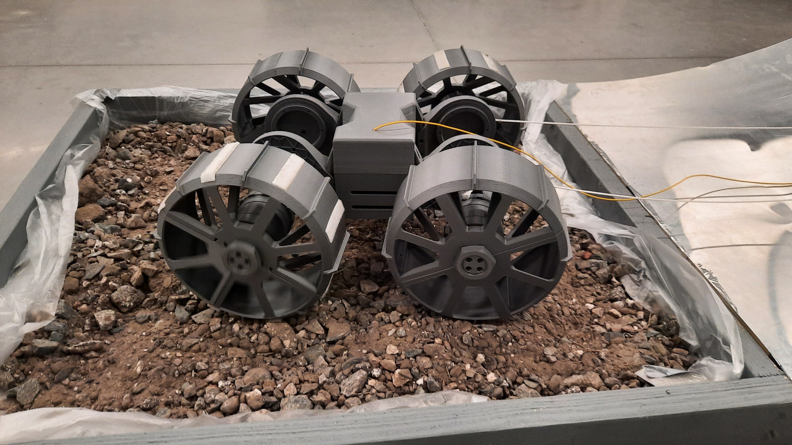
Lunar Rover Trench Digger
Capstone Team 7
Notes:
Hello we are Capstone Team 7 and we are working on a Lunar Rover Trench Digger.
Here we have a picture of our rassor rover that we are working with. Nasa informed us it has a mother rover and that we can assume it transports it, charges it, and it can be used for long distance communication.

Slide 2
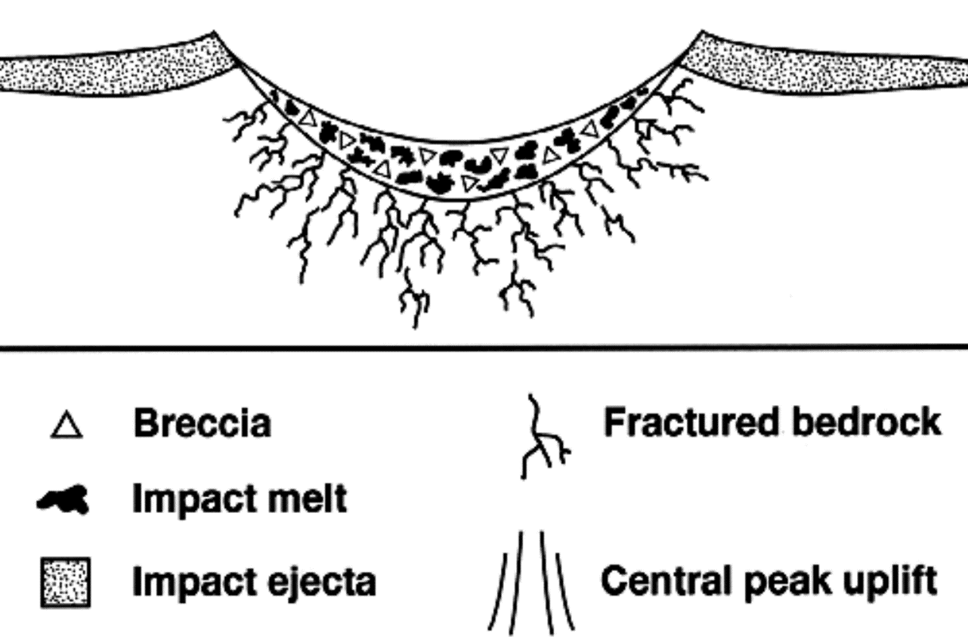
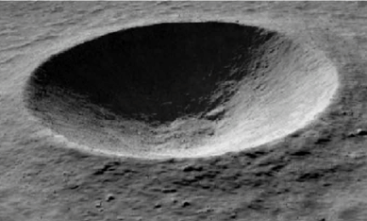

Lunar South Pole
Talk about breccia/basalt and regolith/sandstone.
Water ice in craters.
Hard to get in and out of them.
NASA wants to colonize the moon, they need water ice.
[1] https://www.lpi.usra.edu/science/kiefer/Education/SSRG2-Craters/craterstructure.html
Lunar south pole has craters with water ice in them
Lunar south pole is where NASA is looking
Getting into and out of these craters is not easy

Slide 3
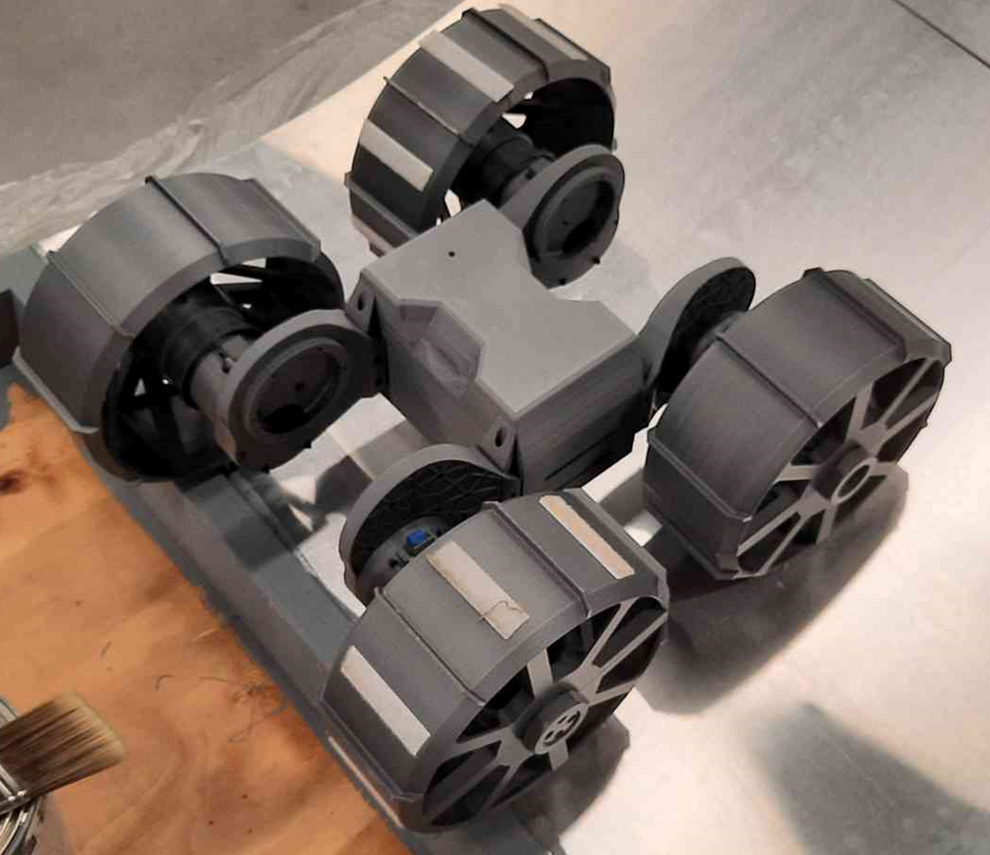
Problem Statement
Enable Easy Access
Traversable by any rover
15 Degree Slope
1cm Surface Variance
Through Basalt & Sandstone
150MPa & 20 MPa
Optimize for Longevity
1.5km

Slide 4
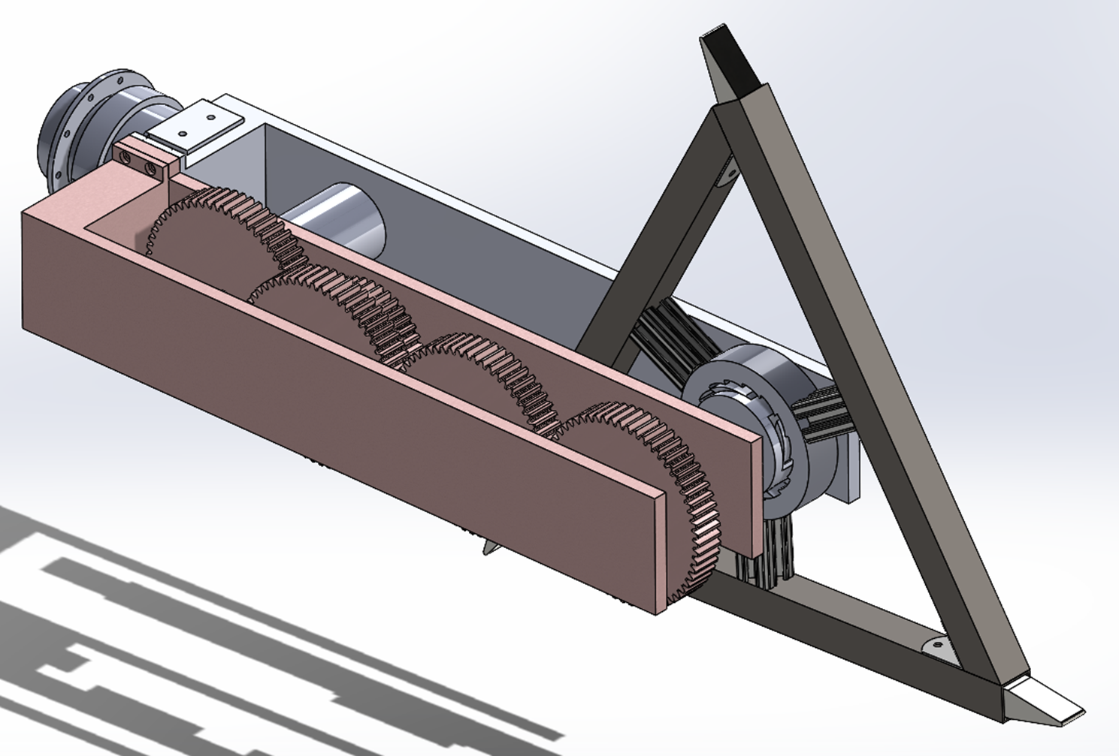
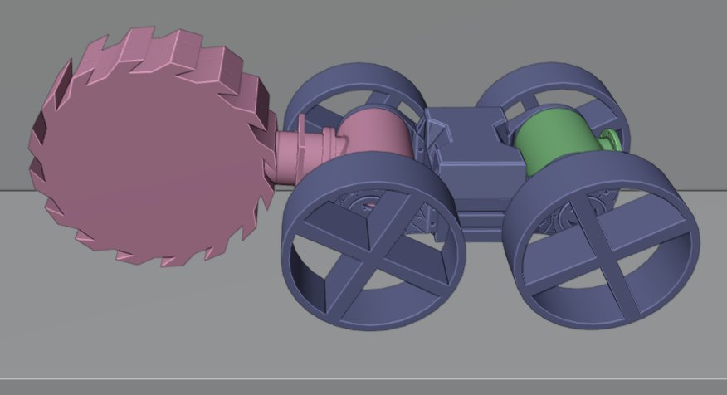
Deliverables
Develop
Breaker Arm
Controlling Code
Configuration GUI
Deliver
Demonstration
CAD Files
Controlling Code

Slide 5
Customer Needs
Criteria | Weight | Justifications
Sandstone Speed | 10 | High Volume
Toolhead Durability | 9 | Longevity
Basalt Speed | 7 | Initial Hurdle
Flatness | 5 | High Tolerance
Power Efficiency | 5 | Faster Excavation
Autonomy | 5 | Faster Excavation
Kickback Stress | 3 | Longevity

Slide 6
Pugh Matrix
 | Chisel | Drill | Focused Solar | Weights
Sandstone Speed | 1 | 0 | -1 | 10
Toolhead Durability | 1 | 0 | 1 | 9
Basalt Speed | -1 | 0 | -1 | 7
Flatness | 1 | 0 | -1 | 5
Power Efficiency | 0 | 0 | 1 | 5
Autonomy | -1 | 0 | -1 | 5
Kickback Stress | -1 | 0 | 1 | 3
Total Scores | 9 | 0 | -10
Ranks | Best | Datum | Worst

Slide 7
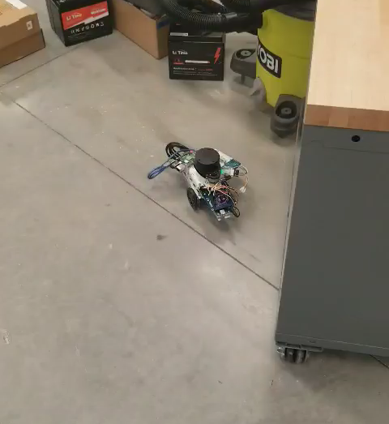
Isolated LiDAR Demo
Lessons Learned
Arduino/Pi Distinction
Arduino/Pi Connection
Motor control processing
Processing LiDAR data
Changing path in realtime
Arduino controls motors. Raspberry Pi handles calculations.
Using Serial Communication was the best method for sending data back and forth to Arduino and Raspberry Pi.
Motor control is processed after the algorithm determines the best path to take.

Slide 8
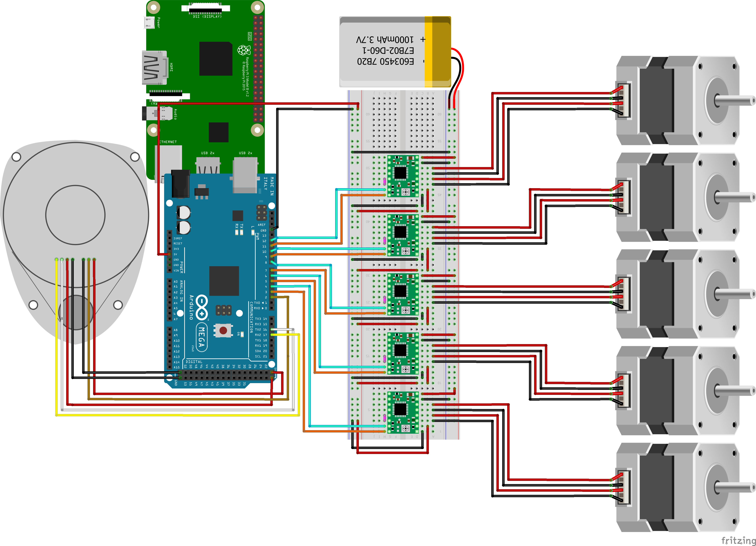
Wiring Diagram
NEMA 23
NEMA 23
Lessons Learned
NEMA 17
NEMA 17
Arduino controls motors. Raspberry Pi handles calculations.
Using Serial Communication was the best method for sending data back and forth to Arduino and Raspberry Pi.
Motor control is processed after the algorithm determines the best path to take.
NEMA 17

Slide 9
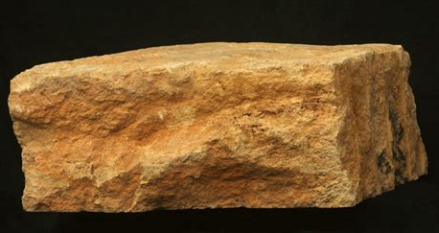
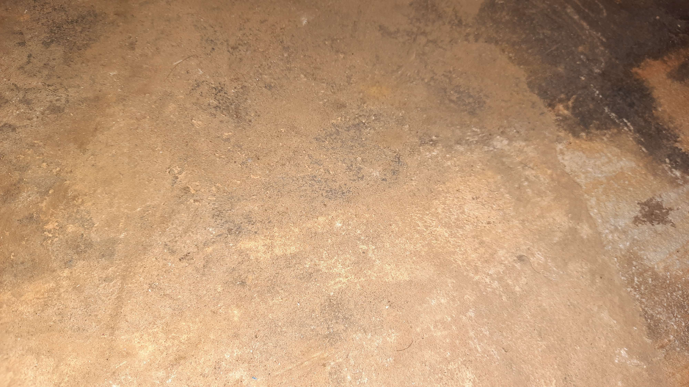


Rock ID Integrated
Capture Image
Export to Model
Classification
Sandstone
Basalt

Slide 10
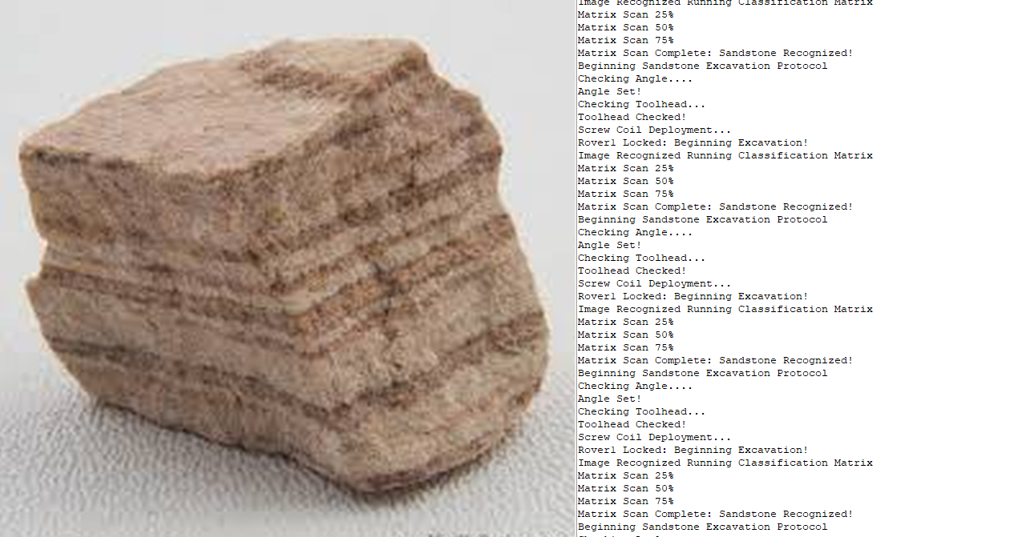
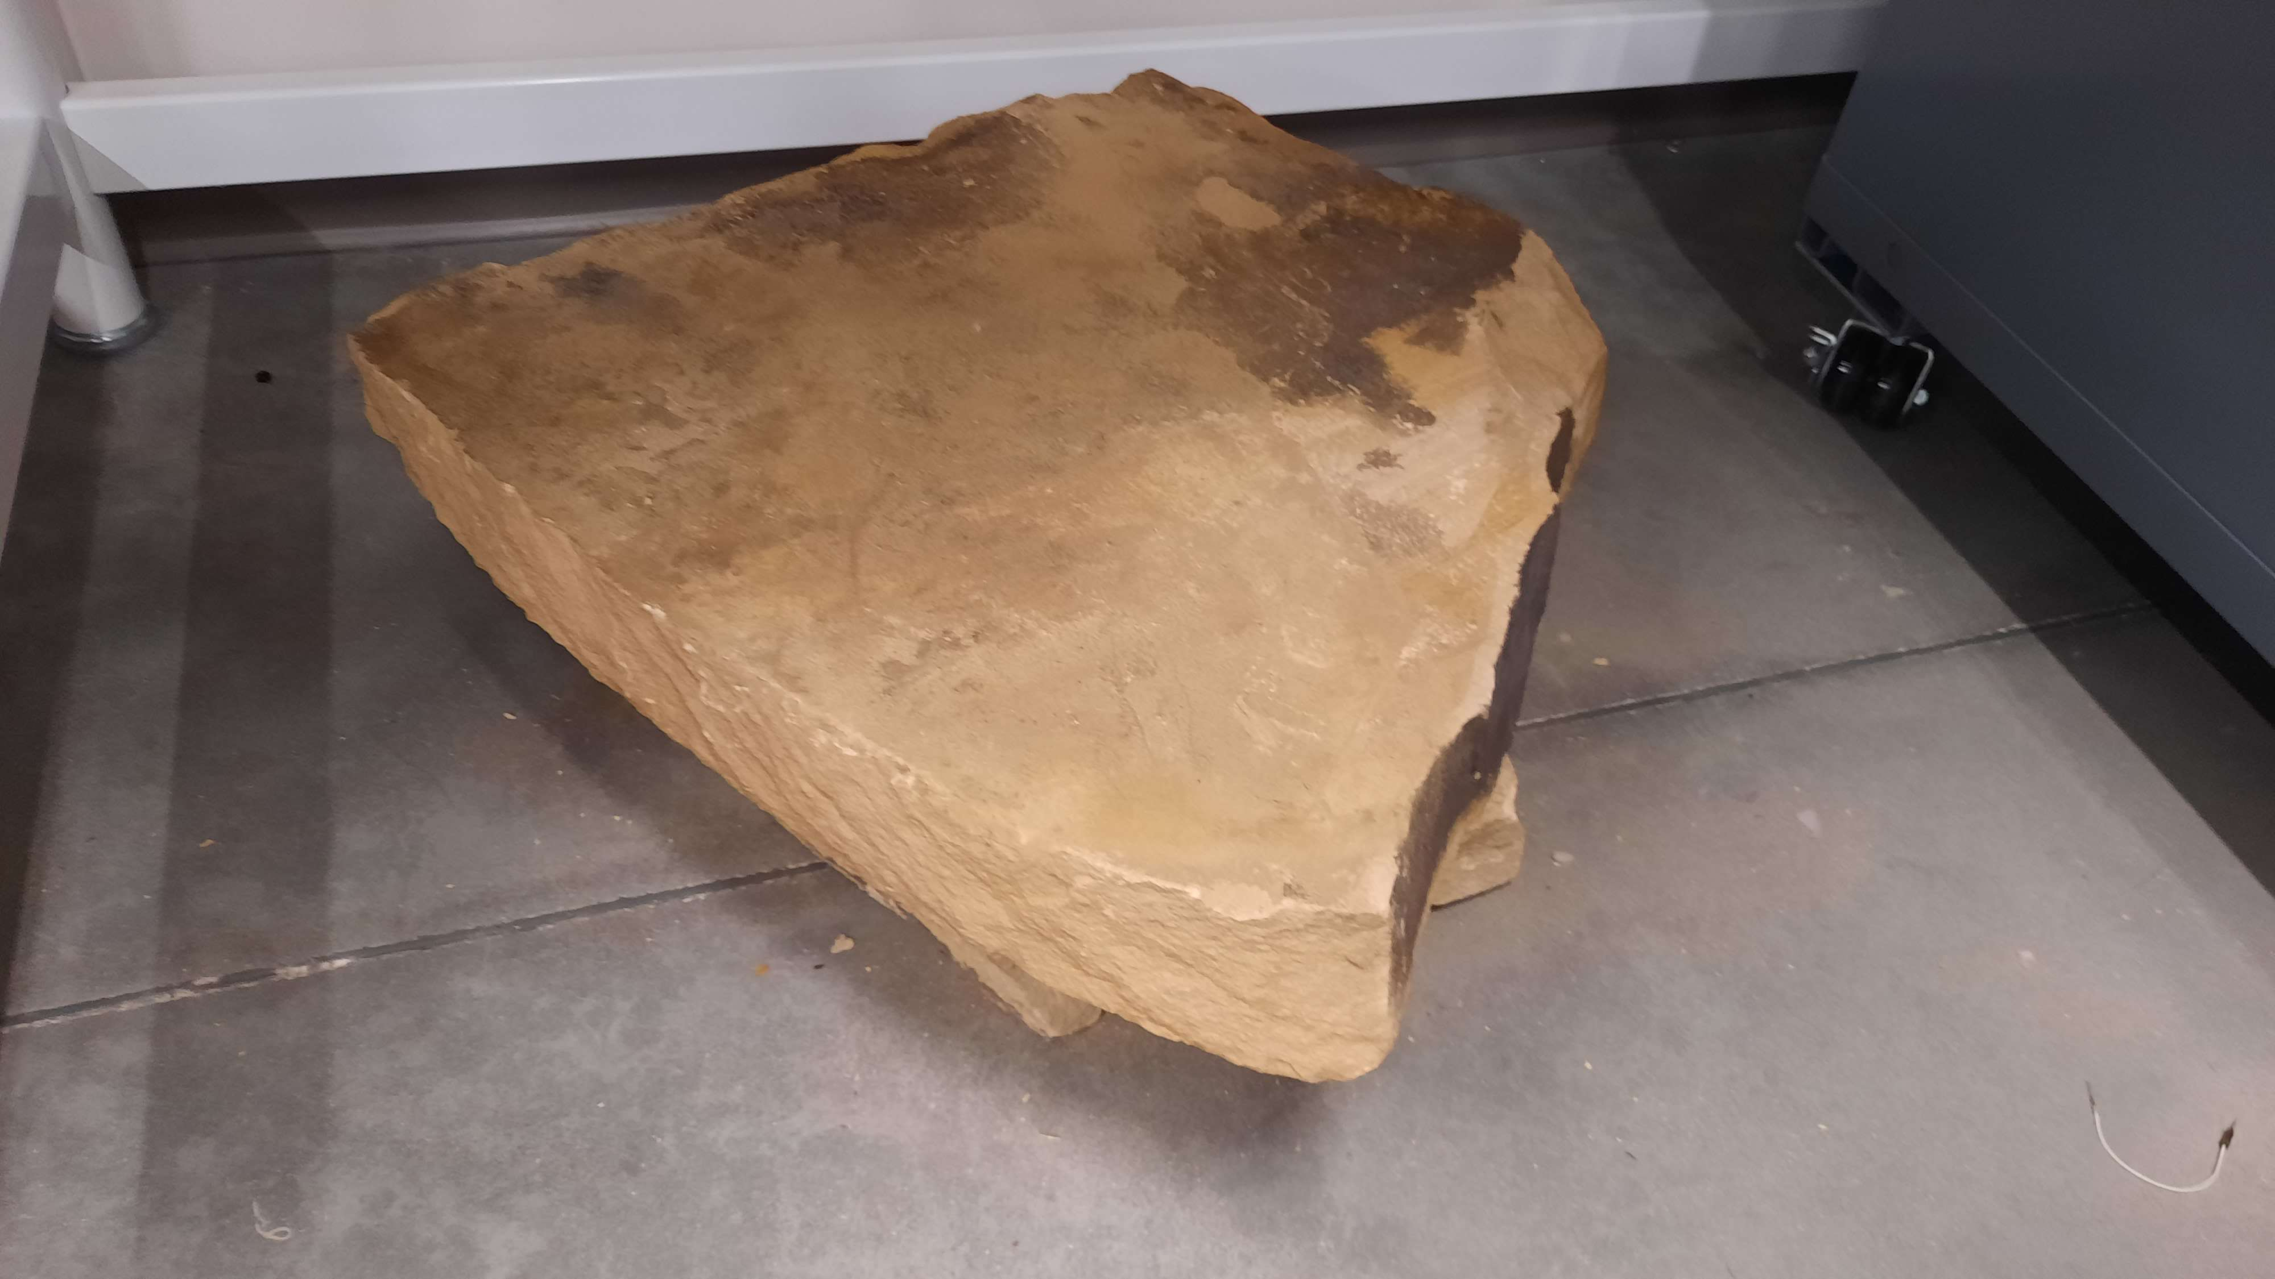
External ROS UI Roadmap

Slide 11
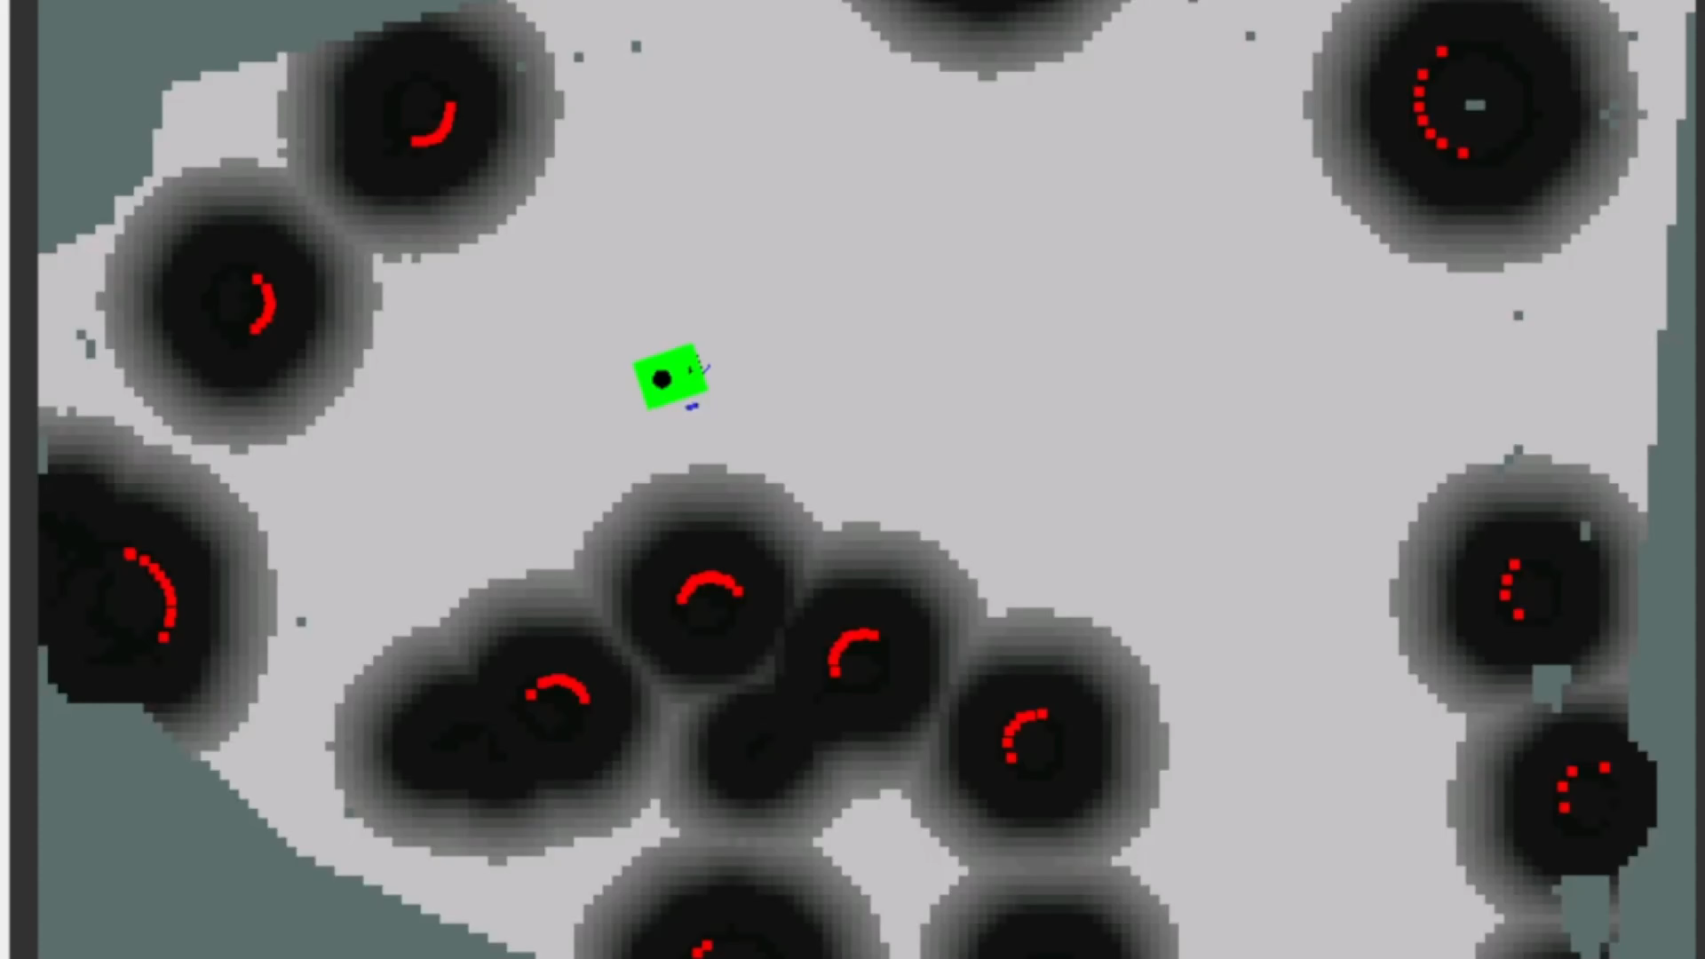
ROS Demo
Mount T-Joint to plate
Attach arm to T-Joint
Connect to controlling software
Adjust ROS parameters to fit
Run cutting sweep

Slide 12
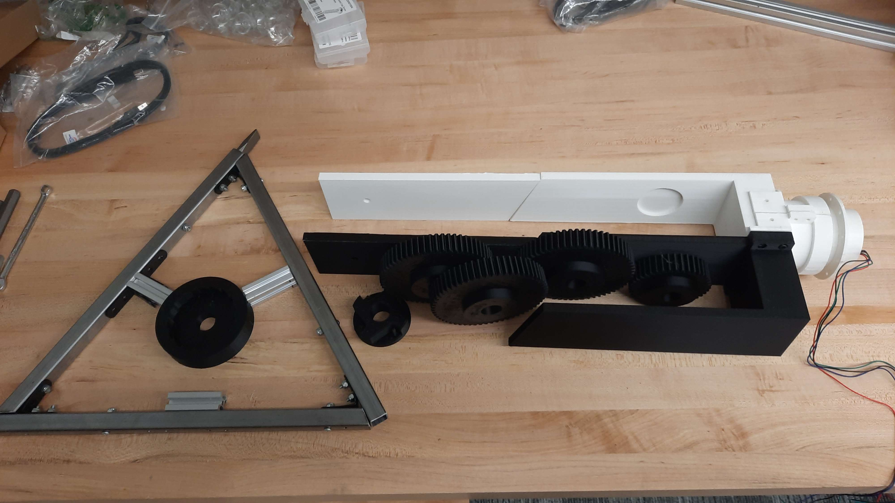
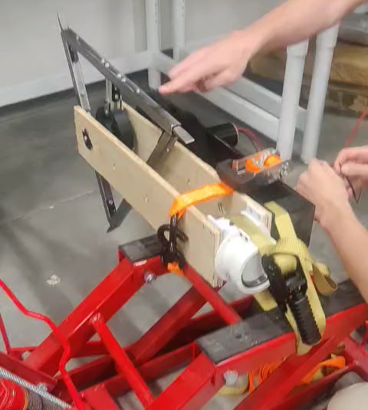
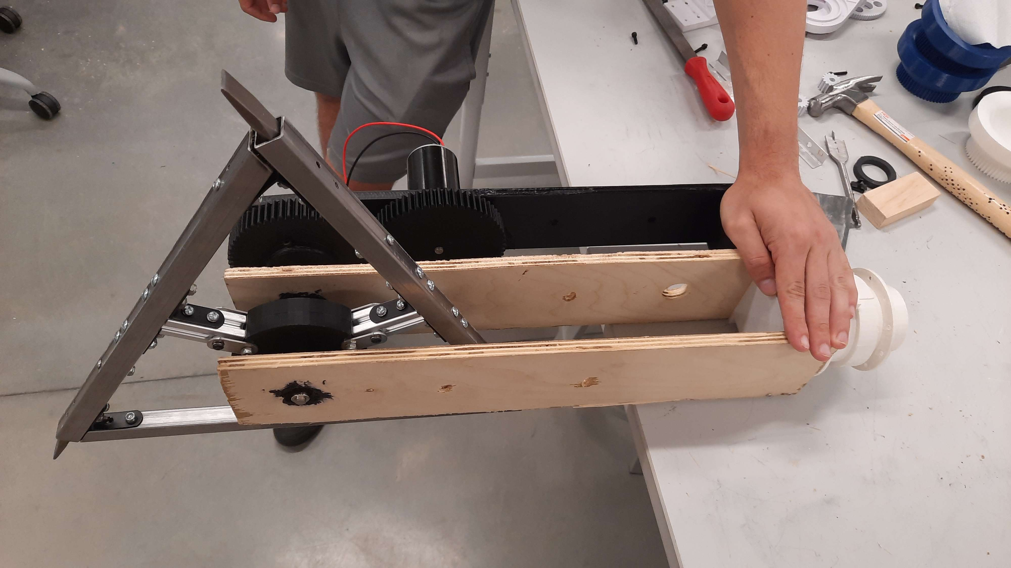
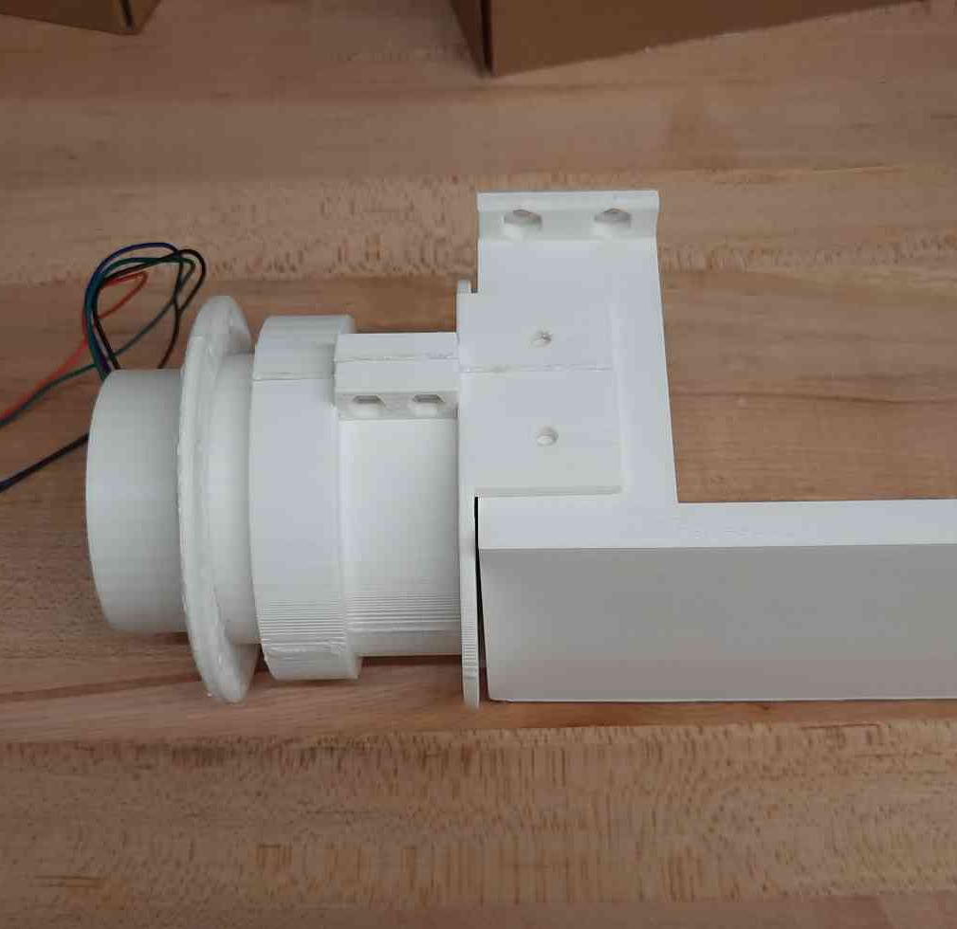
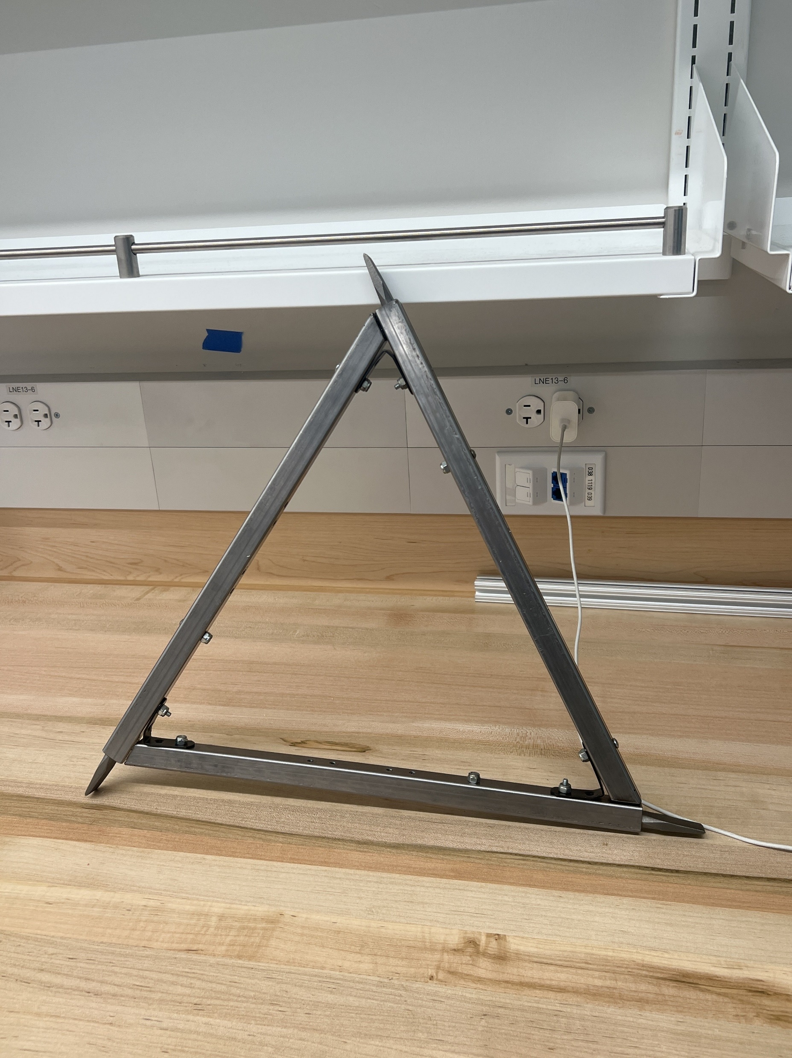
Breaker Arm

